Slide 1
Scientific Machine Learning and Tensorflow tutorial
Neural Networks
Ravi G. Patel
Scientific Machine Learning Department
February 1 – 2, 2024
Numerical PDEs: Analysis, Algorithms, and Data Challenges
ICERM
Brown University

Slide 2
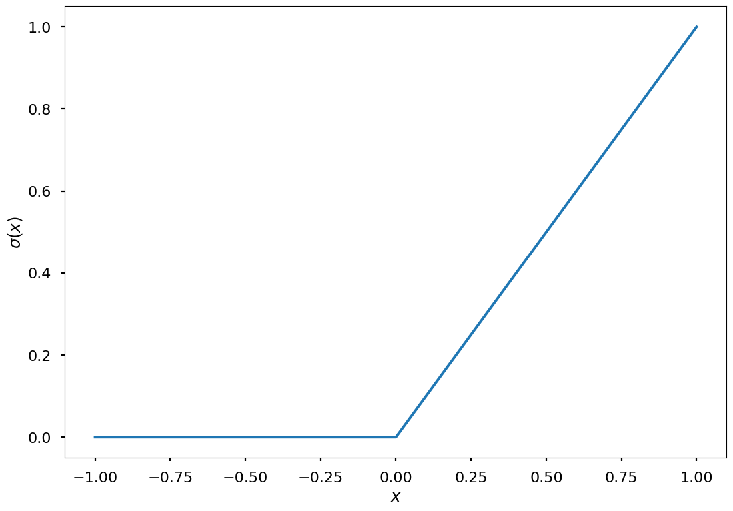
What are Neural networks?
Neural networks are a type of “brain inspired” function approximation scheme
A single “hidden layer” network is the composition of an elementwise nonlinearity sandwiched between two affine transformations
By choosing the right the weights and biases, neural networks can approximate any function

Slide 3
What are Deep Neural networks (DNN’s)?
Deep neural networks compose these layers together,

Slide 4
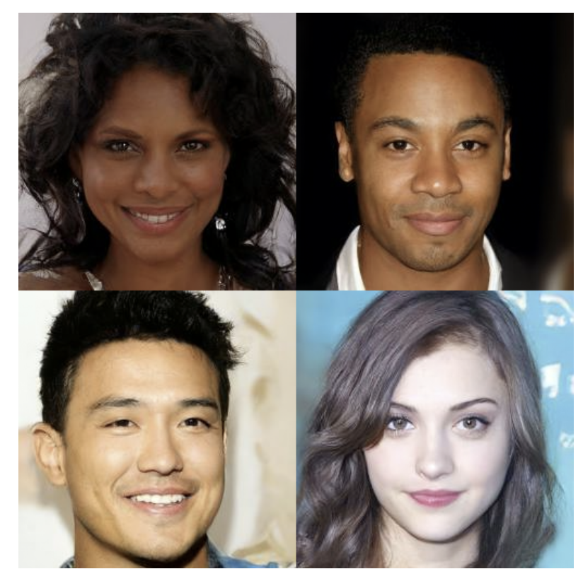
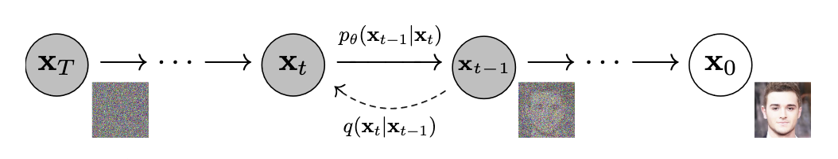
Why use neural networks?
They tend to be excellent high dimensional approximators
Mostly empirical evidence
Some theoretical results
A. Choromanska et al., AISTATS (2015)
Simple to implement
Efficiently runs on GPU’s
Specialized hardware
Diffusion models use neural networks to learn denoising maps for images J. Ho et al., NeurIPS (2020)

Slide 5
Graphical representations of Neural networks
Neural networks are often represented graphically,

Slide 6
Graphical representations of Neural networks
Neural networks are often represented graphically,
Input layer

Slide 7
Graphical representations of Neural networks
Neural networks are often represented graphically,
Output layer

Slide 8
Graphical representations of Neural networks
Neural networks are often represented graphically,
Hidden layer

Slide 9
Graphical representations of Neural networks
Neural networks are often represented graphically,
Width of the layer

Slide 10
Graphical representations of Neural networks
Neural networks are often represented graphically,
Depth of the network

Slide 11
Neural network training
Neural networks are universal approximators
For any function, , there’s a neural network with error¹,
Constructive proofs are not generally available
We use optimization to train the neural network, i.e. regression
Say we have pairs of data
We find the weights and biases of the network,
¹G. Cybenko, MCSS (1989)

Slide 12
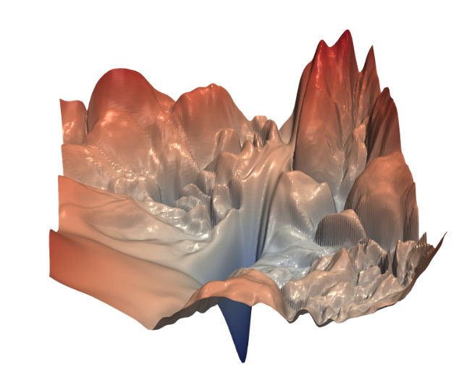
Optimization for neural networks
The loss surface is not convex and high dimensional
Can’t find the global minimizer
Empirical and theoretical results suggest that all local minima are roughly equivalent
A 2d slice of the loss surface of ResNet-56 H. Li et al., NeurIPS (2018)

Slide 13
Reverse mode automatic differentiation (backprop)
We can find optimal weights for a neural network using constrained optimization¹
Many objective functions can be represented by a directed acyclic graph (DAG)
Functions at nodes, , and data at edges,
¹T. Vieira, https://timvieira.github.io/blog/post/2017/08/18/backprop-is-not-just-the-chain-rule/

Slide 14
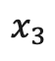
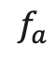
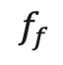
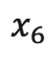
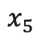
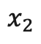
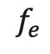
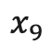
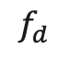
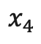
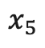
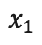
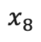
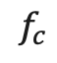
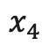
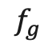
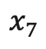
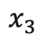
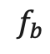
Reverse mode automatic differentiation (backprop)
$$x_{1}$$
$$x_{3}$$
$$f_{d}$$
$$f_{a}$$
The optimal weights are found at a critical point of the Lagrangian,
$$x_{3}$$
$$x_{6}$$
$$x_{5}$$
$$f_{c}$$
$$f_{e}$$
$$x_{7}$$
$$x_{4}$$
$$x_{9}$$
$$f_{g}$$
$$x_{2}$$
$$x_{5}$$
$$f_{b}$$
$$x_{4}$$
$$f_{f}$$
$$x_{8}$$

Slide 15
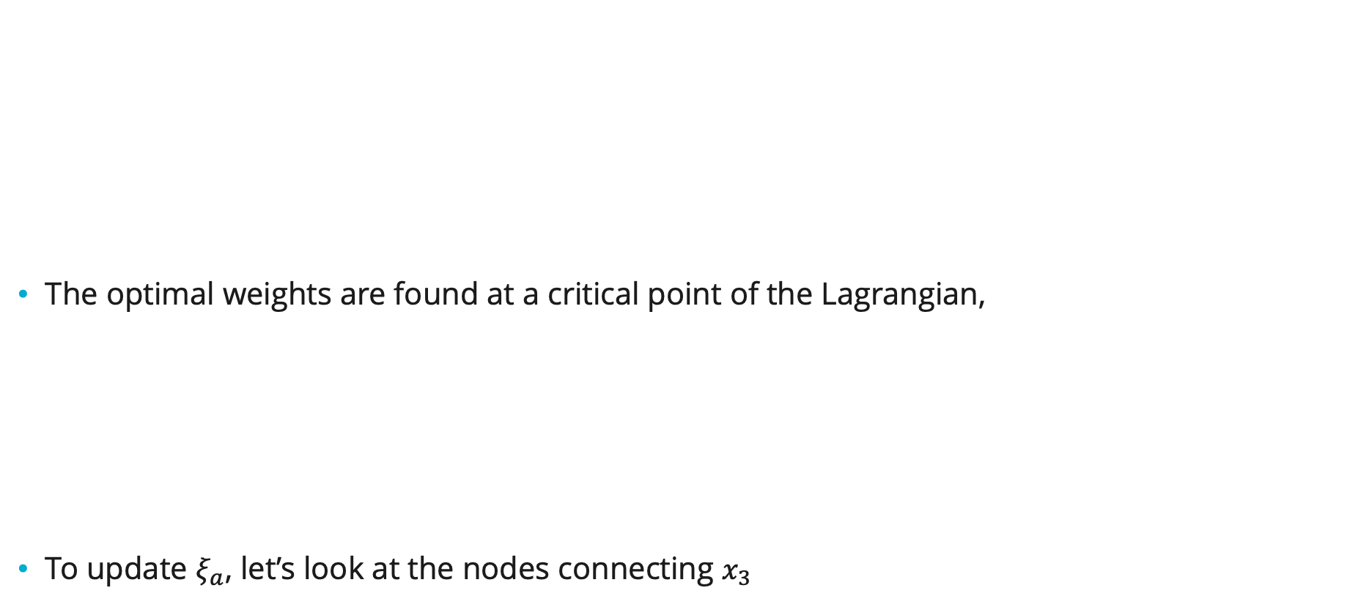
Reverse mode automatic differentiation (backprop)
$$x_{1}$$
$$x_{3}$$
$$f_{d}$$
$$f_{a}$$
The optimal weights are found at a critical point of the Lagrangian,
To update $ξ_{a}$, let’s look at the nodes connecting $x_{3}$
$$x_{3}$$
$$x_{6}$$
$$x_{5}$$
$$f_{c}$$
$$f_{e}$$
$$x_{7}$$
$$x_{4}$$
$$x_{9}$$
$$f_{g}$$
$$x_{2}$$
$$x_{5}$$
$$f_{b}$$
$$x_{4}$$
$$f_{f}$$
$$x_{8}$$

Slide 16
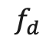
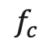
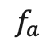
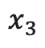
Reverse mode automatic differentiation (backprop)
$$x_{3}$$
The critical points are found when,
Forward pass,
Reverse pass,
Update,
Can’t find exactly, so we update iteratively. E.g., using gradient descent,
is a function of the after it, which are all functions of the before them, and so on.
If you write out explicitly, it’s the chain rule for , working backwards from
Let’s write this as,
$$f_{d}$$
$$f_{a}$$
$$x_{3}$$
$$f_{c}$$

Slide 17
Reverse mode automatic differentiation (backprop)
Constrained optimization reverses the flow of computation,
The reverse pass has the same computational complexity as the forward pass
Easy to implement and optimize -> TensorFlow

Slide 18
Backprop generalizations
The data can live in more general spaces as long as there’s a differentiable inner product,
Replace product between the Lagrange multiplier and function output with the inner product,
E.g., the data can be finite dimensional vectors,
E.g., the data comes from an ODE (see the Neural ODE¹ and adjoint sensitivity²),
¹R. Chen et al., NeurIPS (2018)
²A. Bradley, PDE-constrained optimization and the adjoint method (2019)

Slide 19
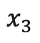
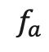
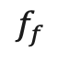
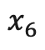
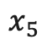
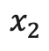
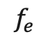
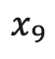
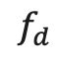
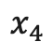
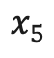
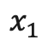
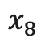
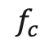

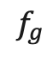


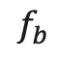
Alternative to backprop - Forward mode automatic differentiation
Instead of backprop, forward mode automatic differentiation follows the same data flow as computing the objective function
But we also compute the Jacobian along the way using the chain rule, e.g.,
Tends to be more expensive when the output is lower dimensional than the input
$$x_{1}$$
$$x_{3}$$
$$f_{d}$$
$$f_{a}$$
$$x_{3}$$
$$x_{6}$$
$$x_{5}$$
$$f_{c}$$
$$f_{e}$$
$$x_{7}$$
$$x_{4}$$
$$x_{9}$$
$$f_{g}$$
$$x_{2}$$
$$x_{5}$$
$$f_{b}$$
$$x_{4}$$
$$f_{f}$$
$$x_{8}$$

Slide 20
Updating the weights and biases
Typically we use first order optimizers to update the weights and biases, e.g. gradient descent,
More sophisticated optimizers will include
Momentum
Decay
ADAM is probably the most popular, (Kingma and Ba, arXiv:1412.6980, (2014))

Slide 21
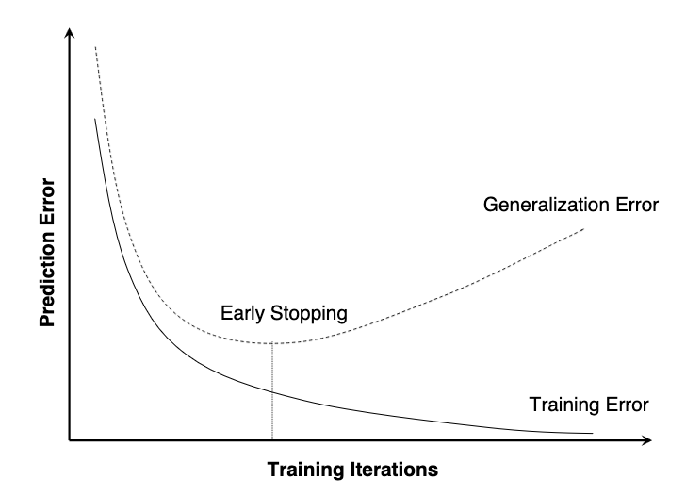
Best practices for training
Usually at every iteration, estimates of the gradient, , are computed from a subset of the data, i.e., minibatching
Faster updates – don’t have to process all the data at once
Extra noise helps with saddle points
An epoch is a set of updates using all of the minibatches
Separate data into three sets,
60% training data – use this to compute the gradients for your optimizer
20% validation data – use this to evaluate your objective function while training, validation loss
20% test data – report this as your model error
Learning curve for a neural network C. Perlich, IBM Research Report (2009)

Slide 22
Regularization
There’s several techniques to prevent overfitting
Weight decay, regularization of the neural network parameters,
Lasso regularization, regularization of the neural network parameters,
Dropout, stochastically set a percentage of the weights to zero during training

Slide 23
Neural network variants
Dense Network
We’ve been looking at a dense neural network,

Slide 24
Neural network variants
Dense Network
Let’s use a simplified representation,

Slide 25
Neural network variants
Residual Neural Network (ResNet)
For deep ResNets there is a connection to ODE’s via the Forward Euler discretization,

Slide 26
Neural network variants
Recurrent Neural Network (RNN)
Reuse the same weights between layers
Useful for time series
Unroll

Slide 27
Neural network variants
Convolutional Neural Network (ConvNet)
For spatial data on a grid, ConvNets use a banded structure for the weights. For 2D,
Typically, we’ll also map between multiple channels, e.g., RGB in an image

Slide 28
Neural network variants
Graph Neural Network (GNN)
Convolutions can be generalized to work on graphs,

Slide 29
Neural networks in tensorflow
There are two ways to build and train neural networks in TensorFlow
Manually
Keras Library
Neural networks “layers”
Models composed of layers
Optimizers
Regularizers
Metrics
Callbacks
Let’s look at some code examples

Slide 30
Exercise
Use a neural network to fit the 2D function in the unit box,
Try both the low level interface and the Keras interface
Experiment with different architectures and optimizers

